Slide 1
Memory Management
Module CSN08101
Systems and Services
School of Computing Napier University

Slide 2
Learning Outcomes
➘ This handout is intended to help you to:
➘ Further develop the ideas of how
processes are held in memory.
➘ Appreciate the reasons for memory
management sub-systems.
➘ Understand the operation of paged
virtual memories.

Slide 3
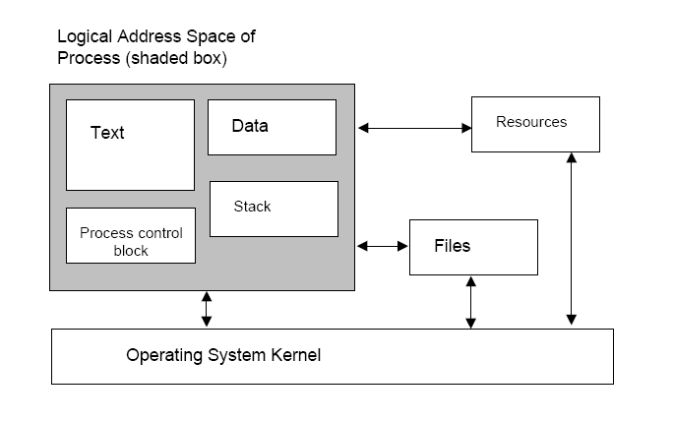
Processes in memory -1

Slide 4
Processes in memory -2
➘ A process in memory (shaded box on earlier slide) is structured as:
➘ Space for instructions (code) - The process “text” whose instructions
define the behaviour of the process.
➘ Volatile Data Storage. (e.g. the stack):
➘ Data declared by the user,
➘ e.g. in inner blocks of code, or data divisions of a module
➘ Partial results generated by the program,
➘ Addresses calculated by the program.
➘ (e.g. return addresses in procedure calls)
➘ Linkages to other system resources (Process data)
➘ Buffers to hold input/output data.
➘ Device managers,semaphores,static data etc)
➘ Process Control Block holds “housekeeping” details of the process.
➘ Space to save register values when process is blocked or
ready-to-run.

Slide 5
Why memory management?
➘ Memory management facilities are needed because:
➘ Relocation -
➘ Process images may be moved around during execution
➘ A blocked process may be moved to disk then later reloaded into a different area
of RAM.
➘ As processes are started they request memory from the operating system, and as they
end, the memory they “own” is released.
➘ Protection -
➘ Processes must not access memory allocated to other processes, except when
allowed by the operating system (see “sharing” below).
➘ The “General Protection Fault” in Windows arises from this protection.
➘ Every address referenced by a process (i.e. set into the MAR) must be checked
before use.
➘ This checking is usually done by memory management hardware (a motherboard chip).
➘ Sharing -
➘ Processes may need to share re-entrant code, or global data.
➘ The OS allows access to designated common areas (e.g. buffers for input/output
data).

Slide 6
Partitioned memory -1
➘ Early methods memory management methods were based on partitions:
➘ A “map” of available memory was maintained to show “free” memory.
➘ New processes were written into continuous areas (partitions) which
were at least large enough to hold them.
➘ When a process ended the memory was returned to the free memory.
➘ All addresses generated during process execution were compared with
the registers holding upper and lower limits of the address range for the
partition to prevent “illegal” accesses.
➘ Processes were held initially on disk as executable images waiting to be
loaded into memory and have relative addresses converted to physical.
➘ Fixed partition memory
➘ Partition boundaries were fixed by the OS (i.e. a list of partitions and
sizes):
➘ Unused space in a partition could not be used by another process:
➘ Large processes could be held up if larger partitions were used by
small processes

Slide 7
Partitioned memory -2
➘ Variable partition memory
➘ Logical partitions based on space used by the process.
➘ New processes loaded into any free space large enough to hold it.
➘ Unused space between loaded processes which was too small for any
process was unable to be used until:
➘ An adjacent process finished and its space became free also, or
➘ A special process (called a “memory compacter”) shuffled all
processes into a contiguous set with all the free space in single
area at top of memory. This operation takes up time. (analogous to
disk defragmentation)
➘ All physical addresses require to be recalculated if a process is moved.
➘ Both fixed and variable partition approaches suffer from fragmentation –
areas of memory too small for waiting processes.
➘ Modern systems use special variants of fixed partition memory: paged
virtual memory, or segmented virtual memory.
➘ Special chips contain hardware support for memory management.

Slide 8
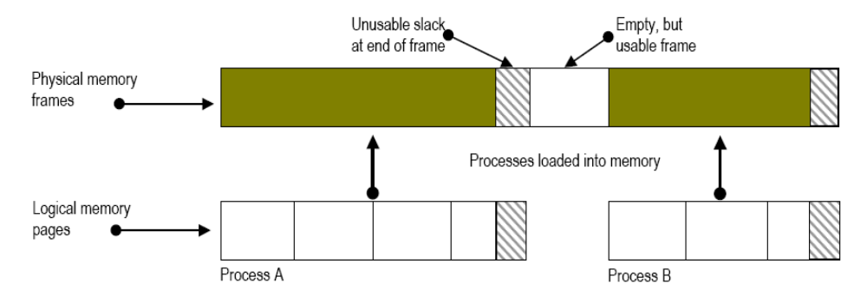
Paged Memory –1 : pages and frames
➘ Physical memory is divided into equal, fixed-size page frames, or
simply frames.
➘ Logical memory partitioned into pages of same size as frames.
➘ On activating a job, a minimum subset of its pages are loaded into
unused frames.
➘ Wasted memory occurs only on last page/frame of process
➘ Holes (unused pages) can occur, but this can be eliminated in
paged virtual memories.

Slide 9
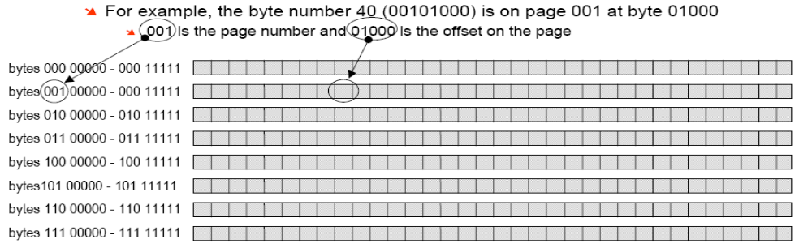
Paged Memory –2 : addressing
➘ Consider a memory containing 256 bytes, numbered from 0 to 255.
➘ To label each byte in the range 0-255 requires 8-bit addresses
[0000 0000 - 1111 1111]
➘ This memory can be treated as 8 pages, each of 32 bytes
➘ Page 0, bytes 0-31; page 1, bytes 0-31; ….; Page 6, bytes 0-
31; Page 7, bytes 0-31
➘ In binary, the pages are numbered 000 - 111 and the bytes
00000 - 11111

Slide 10
Paged Memory –3 : page numbers and offsets
➘ All addresses are structured:
➘ {page-no} {page offset}
➘ For page size = L, and a logical address = A the effective address is:
➘ page no. := integer (A/L) [ that is, the integer result of dividing A
by L ]
➘ page offset := A modulo L [ that is, the remainder when dividing
A by L ]
➘ For example, A = 196 and L = 32
➘ The page is (196/32) = 6 and the offset on the page is (196 mod 32) = 4
➘ If all sizes are multiples of 2 the arithmetic becomes very simple in binary:
➘ A memory of 256 bytes (=2⁸) needs 8 bits for the address of each byte
➘ For a page size of 32 (= 2⁵) we require 5 bits to number each byte
➘ There are 8 pages (= 2³) so 3 bits are needed for each page number
➘ In binary,196 = 11000100 :
➘ The first 3 bits give the page number (110 equivalent to decimal 6)
➘ The last 5 bits give the offset of the byte on the page (00100 - decimal 4)

Slide 11
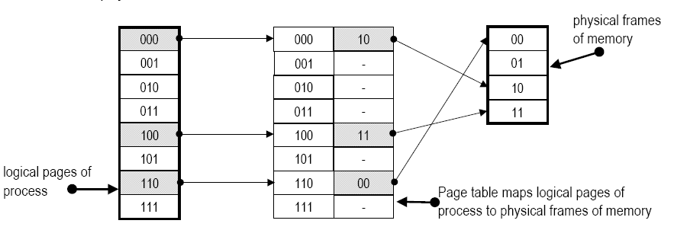
Paged Memory –4 : the page table
➘ A “page table” is used to map logical addresses to physical addresses:
➘ The page number is used to look up the table.
➘ If the page is in memory, the table entry gives the frame number
➘ Because frames and pages are the same size, the offset does not
change.
➘ Paging is a form of dynamic relocation - every logical address maps
dynamically to some physical address at the time of reference.

Slide 12
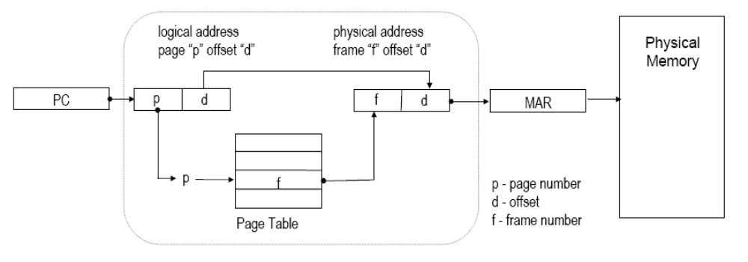
Paged memory - : basic address translation.
➘ Address translation is done dynamically in hardware of the MMU
➘ Logical address from Program Counter is sliced to give page and offset
➘ Page number indexes the Page Table to obtain Frame number
[ f=PT(p) ]
➘ Frame number forms upper bits of MAR
➘ Offset (or displacement) passes through unchanged lower bits of
MAR

Slide 13
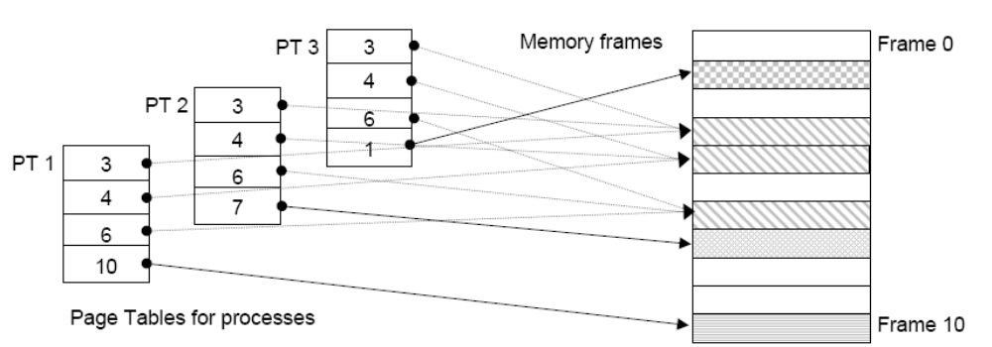
Paged Memory - : sharing pages and frames
➘ Processes may share pages if they are read-only
➘ read-only data or re-entrant “execute-only” code
➘ Page table entries contain protection bits/flags to show what is allowed
➘ Attempts at incorrect access are trapped as errors e.g. writing to read-
only page.
➘ Consider 3 users of an editor written in re-entrant code.
➘ Each user has separate data page(s)

Slide 14
Paged Virtual Memory -1
➘ The ideas of paging can be extended to provide a “virtual memory”:
➘ In principle, a process can be “infinitely” large but still run in a finite real
memory.
➘ There can be a large number of such processes.
➘ To achieve this the mechanism for mapping pages to frames through a
page table is modified by adding bits to the page table entries to show:
➘ if that page exists in the process
➘ if that page is currently loaded into a frame or is in the swap file on the
disk.
➘ If a currently loaded page has been changed since it was loaded (e.g.
has it been written to by a process?)
➘ The logical address space of each process in Windows NT is based on
Intel i386 architecture: 4GB with each page is divided into 4KB pages
➘ Logical addresses are 32 bits and 232 = 4GB
➘ A typical memory in a workstation will be between 128 MB and 512 MB

Slide 15
Paged Virtual Memory -2
➘ When a process is running and a logical address is passed to the MMU
the following sequence of events occurs:
➘ Check the page table entry to see if the page holding the required logical
address is in the page table:
yes - access it directly through the page to frame translation.
The process continues as the running process
no - the process blocks and causes a “page fault”
This is an interrupt which requests the MMU to locate the required page
in the swap file and load it into an available frame of memory.
When the page is found there may be no available frames:
The MMU must select a page which will be overwritten by the
requested page. The selection is done by a “page-replacement”
algorithm.
When a page has been selected it may have to be written back to
the swap file to preserve changes, otherwise it is simply overwritten.
➘ The process remains blocked until the required page is in memory.
➘ When unblocked it continues with the memory access to the “new” page

Slide 16
Paged Virtual Memory -3
➘ Benefits:
➘ More processes can be active in a given amount of memory because only
part of each is in memory.
➘ More productive use of memory - most frames are in active use by | currently loaded jobs.
➘ Reduced time for memory management - swapping time more
productive.
➘ Costs
➘ Complex memory management subsystems
➘ Hardware based address translation using special purpose chips
➘ Complex models of process address spaces
➘ Mapping of processes to memory
➘ Algorithms for selecting which pages to move from memory to disk (page
replacement)
➘ Management of swap file(s) on disk

